Slide 1

Digital Forensics Project Network Pattern Analyzer: Visualizing Network Traffic Dynamics through Heatmaps using Wireshark
Presented By:
Sindhuja Baikadi(1)
02128756

Slide 2
Introduction
Network Pattern Analyzer is a network analysis tool designed to evaluate traffic through PCAP/PCAPNG files. This Python-based utility processes these network traces and creates a heatmap representation, detailing the data transfer volumes between network endpoints.
Few tools are as useful to the IT professional as Wireshark, the go-to network packet capture tool. Wireshark will help to capture network packets and display them at a granular level.
What Is Wireshark?
Wireshark is a network protocol analyzer or an application that captures packets from a network connection, such as from your computer to your home office or the internet. The packet is the name given to a discrete unit of data in a typical Ethernet network.

Slide 3
Wireshark is the most often used packet sniffer in the world. Like any other packet sniffer, Wireshark does three things:
Packet Capture: Wireshark listens to a network connection in real-time and then grabs entire streams of traffic – quite possibly tens of thousands of packets at a time.
Filtering: Wireshark is capable of slicing and dicing all of this random live data using filters. By applying a filter, you can obtain just the information you need to see.
Visualization: Wireshark, like any good packet sniffer, allows you to dive right into the very middle of a network packet. It also allows you to visualize entire conversations and network streams.

Slide 4
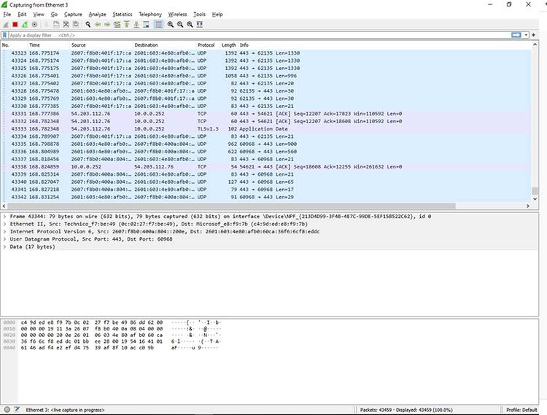
What Is Wireshark Used For?
Wireshark has many uses, including troubleshooting networks that have performance issues.
Cybersecurity professionals often use Wireshark to trace connections, view the contents of suspect network transactions, and identify bursts of network traffic.
It’s a major part of any IT pro’s toolkit –hopefully, the IT pro has the knowledge to use it.

Slide 5
When to Use Wireshark?
Target Users: Ideal for government agencies, educational settings, businesses, and nonprofits to troubleshoot network issues.
Educational Tool: Helps beginners in information security learn network traffic analysis and protocol communication.

Slide 6
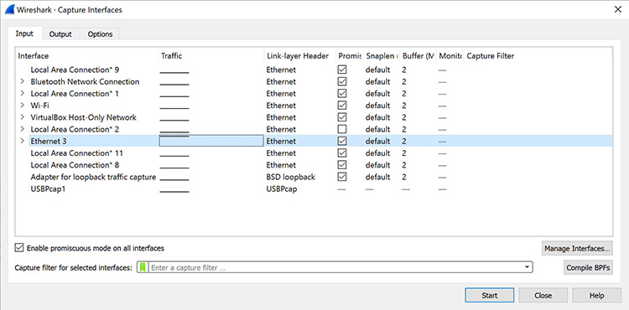
The Capture Interfaces window, as shown below in Figure.
This window will list all available interfaces. In this case, Wireshark provides several to choose from.
Once the network interface is selected, you simply click the Start button to begin your capture. As the capture begins, it’s possible to view the packets.

Slide 7
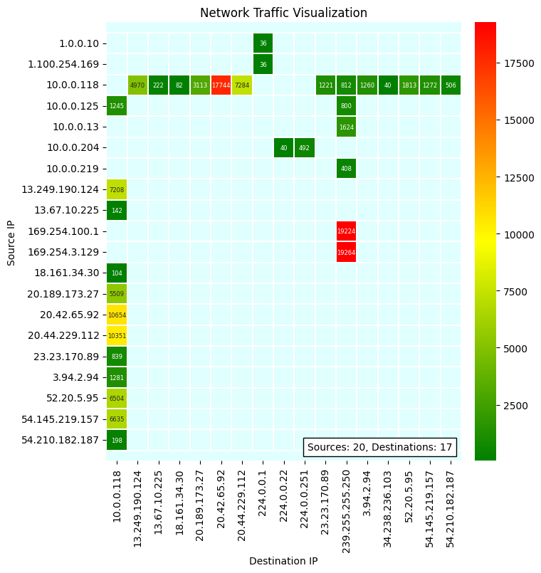
Visualizing Network Traffic with Heat Maps
Data Source: Using PCAP/PCAPNG files generated from network traffic.
Heat Map Insights: The heat map displays data flow between IP addresses. Colors vary from light to dark to indicate the volume of data transferred, ranging from low to high levels.

Slide 8
Limitations of Wireshark
1. Knowledge Required: Effective use requires understanding network operations and protocols like TCP, UDP, DHCP, and ICMP.
2. Limited Traffic Capture: Only captures traffic between the user's computer and directly communicating systems due to modern network switches.
3. No Alerts: Lacks intrusion detection capabilities; does not provide alerts for issues.
4. No Decryption: Unable to decrypt encrypted traffic.
5. IP Spoofing: Cannot verify the authenticity of IP addresses, making spoof detection difficult.

Slide 9
FUTURE ENHANCEMENTS:
Machine Learning for Prediction:
Use machine learning algorithms to predict future traffic patterns or to classify traffic into normal versus potentially malicious activities.
Session Reconstruction:
Reconstruct sessions or conversations from the packet data to analyze the behavior within a single session.
Data Enrichment:
Enrich the packet data with additional information, such as the hostnames associated with IP addresses or the risk score of IPs.
Network Topology:
Use graph theory to create a network graph that shows how different nodes (IP addresses) are connected.

Slide 10

Any Questions? Or Comments

